Slide 1

Overview of N.H. Assessing
January 30, 2020
Whitefield, NH
Samuel Greene, Assistant Director
Municipal and Property Division
Lindsey M. Stepp, Commissioner
Carollynn J. Lear, Assistant Commissioner
109 Pleasant Street, Concord, NH 03301
603-230-5000

Slide 2
Overview of N.H. Assessing
Sam Greene, Assistant Director, Municipal and Property Division
This presentation is intended for informational purposes only, and is not a substitute for seeking professional advice or for reviewing the applicable laws and rules. This presentation represents some positions of the Department on the limited issues discussed herein, based on the law in effect at the time of the presentation and Department interpretation thereof, as well as the opinions and conclusions of its presenter.
For the current status of any tax law, practitioners and taxpayers should consult the source documents (i.e., Revised Statutes Annotated, Rules, Case Law, Session Laws, etc.) for independent verification.
Page 2
Notes:
Attendees should read the disclaimer.

Slide 3
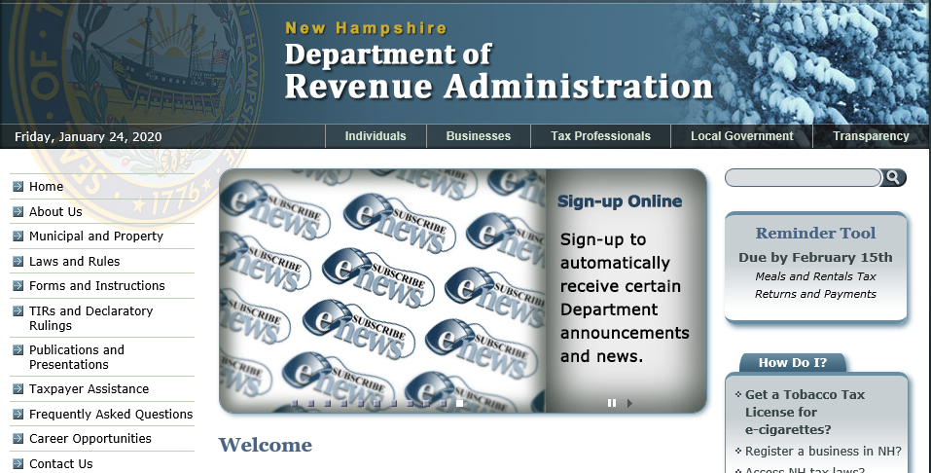

www.nh.gov/revenue
Sam Greene, Assistant Director, Municipal and Property Division
Page 3
Notes:
*Looking for Statutes / Rules / TIRS / Declaratory rulings / tax forms / a current use handbook / educational offerings ? This is the place.
*You can access Municipal and Property Division “clicking” on” either the name or the icon located below. Then choose if you want municipal or property.
*Educational offerings a posted under “Property” “Education”.
*TIRS and Declaratory rulings can also be found here.

Slide 4
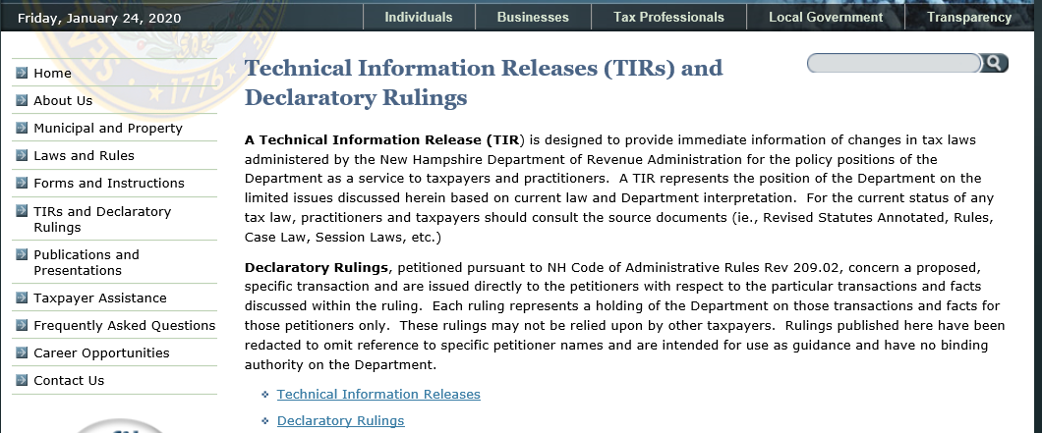
Statutory Changes and Legislative Session Summary
Sam Greene, Assistant Director, Municipal and Property Division
Page 4
Notes:
*Why might this section of the Department’s website be beneficial?
*Immediate information of changes in tax laws
*And, a summary of the changes for the legislative session.

Slide 5
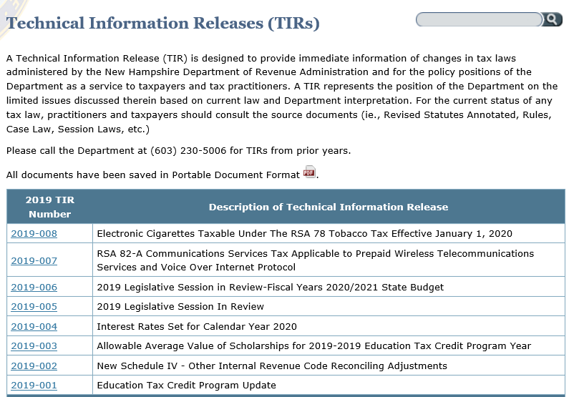
Sam Greene, Assistant Director, Municipal and Property Division
Page 5
Notes:
Extremely helpful information – summarizes as to what the change in the statute did….check it out.

Slide 6
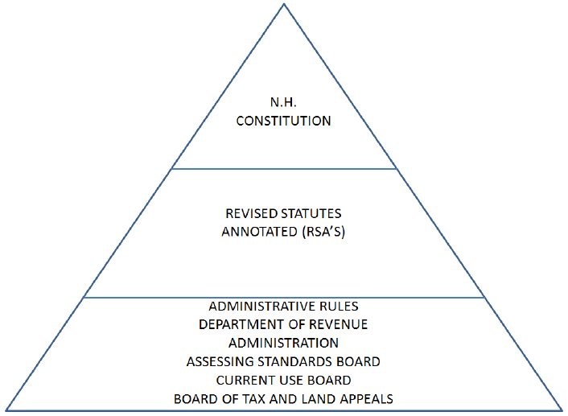
Laws & Rules
Sam Greene, Assistant Director, Municipal and Property Division
Page 6
Notes:
HIGHEST LEVEL – Constitution –this is the expressed will of the people.
*Adopted effective 1784. *First constitution adopted in the United States.
*6 Constitutional Conventions. *144 Amendments
RSA – Legislative – laws of NH. Proposed and adopted by the Legislature, signed by the governor.
*Senate and House of Representatives. *Laws start as LSR’s or Legislative Service Requests.
To be enacted, signed by Governor. Governor can allow law to go into effect without signing.
Veto by Governor can be overridden by 2/3 vote of Senate and House
ADMIN. RULES – Promulgated (or written) by administrative agencies where authorized in RSA.
Administrative Rules in NH have the effect of law. * Adopted by JLCAR (many say it jal*car or j*l-car).
(Joint Legislative Committee on Administrative Rules)
5 members of the State Senate and 5 members of the House of Representatives, with 5 alternates from each chamber to fill in for absent members. The DRA has numerous rules pertaining to statewide taxes, property taxation (Rev. 400, 600,) ASB rules, Cub rules etc.
CASE LAW – As interpreted by court. Only Supreme Court makes case law.
Lower courts and Board of Tax and Land Appeals decisions are advisory only.
When a case is decided by Supreme Court it becomes the “Law of the Land.”
Interprets Constitution, RSA, and Administrative Rules

Slide 7
Municipal and Property Division
Sam Greene, Assistant Director, Municipal and Property Division
Page 7
Notes:
*Looking for Statutes / Rules / TIRS / Declaratory rulings / tax forms / a current use handbook / educational offerings ? This is the place.
*You can access Municipal and Property Division “clicking” on” either the name or the icon located below. Then choose if you want municipal or property.
*Educational offerings a posted under “Property” “Education”.
*TIRS and Declaratory rulings can also be found here.

Slide 8
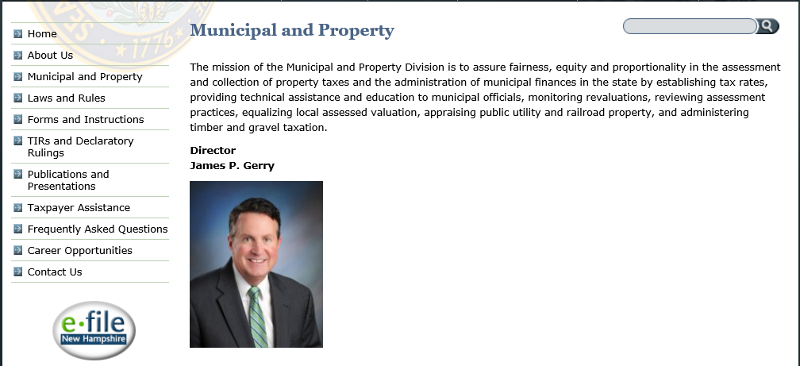
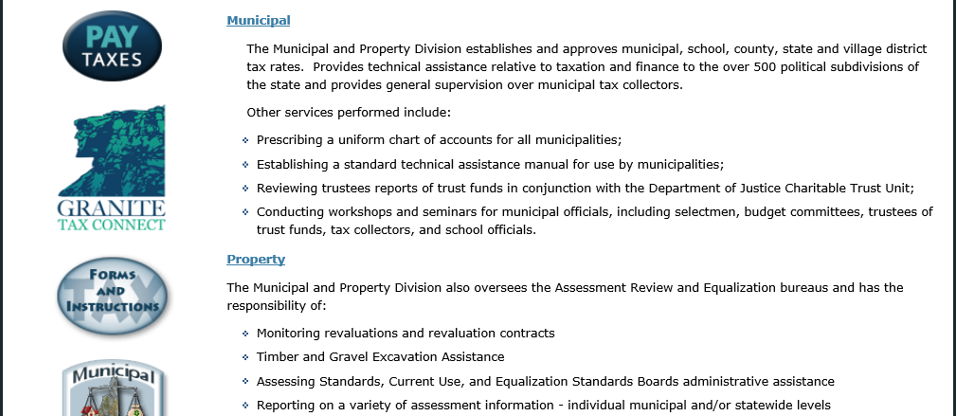
Sam Greene, Assistant Director, Municipal and Property Division
Page 8

Slide 9
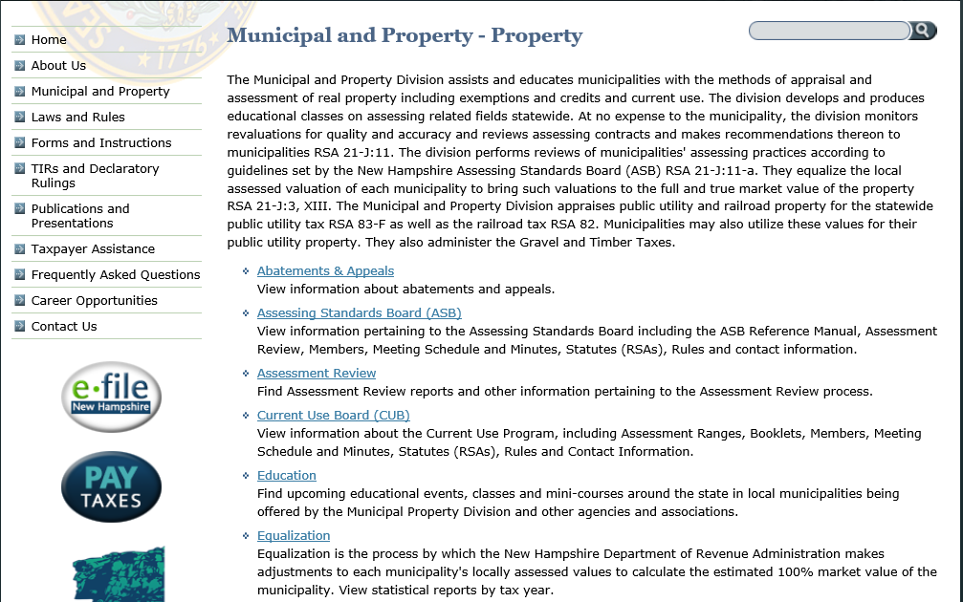
Sam Greene, Assistant Director, Municipal and Property Division
Page 9
Notes:
If you go to the Municipal and Property Section, and click on Property…you will find many helpful areas.
The “Draft” Utility values are provided along with educational offerings and information on “timber” and “gravel”.

Slide 10
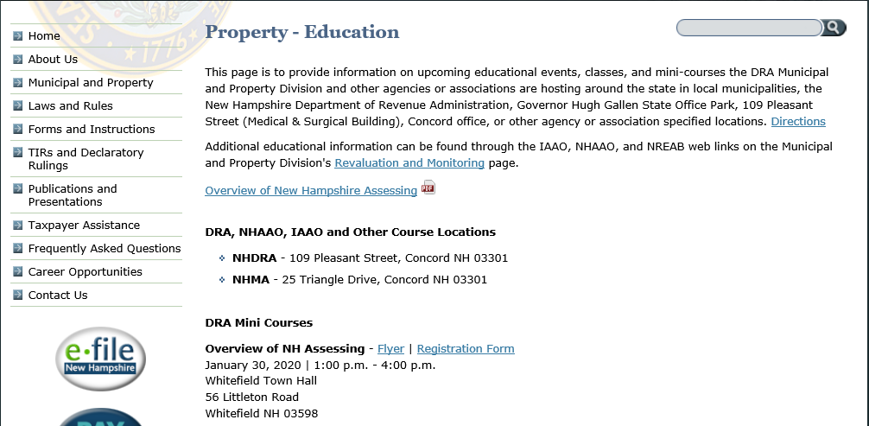
Sam Greene, Assistant Director, Municipal and Property Division
Page 10

Slide 11
  DRA Educational Offerings
Sam Greene, Assistant Director, Municipal and Property Division
The department offers 3-hour mini-courses specifically covering:
  Religious, Educational and Charitable Exemptions
  Exemptions and Tax Credits
  Current Use
  Excavation Tax
  Timber and Excavation Tax combined
  It is recommended that you take the comprehensive State Statute Part I and Part II classes.
  Current class offerings can be found on the Department website at: https://www.revenue.nh.gov/mun-prop/property/education.htm
Page 11
Notes:
*The DRA mini-courses and the State Statutes courses cover the laws and rules in depth.
*The DRA is charged by statute with providing various forms for Tax Credit & Exemptions CU, Excavation & Timber tax. The forms contain very detailed instructions regarding completion of the forms.
*”Exemptions & Credits” focuses in detail on the “personal” exemptions and credits (elderly, veterans, optional) criteria.
*The “misadministration” of exemptions and credits or CU will result in the loss of revenue to the municipality.
*As part of the DRA assessment review, adherence to the exemptions, credits and CU requirements are examined.

Slide 12
Course Outline
Sam Greene, Assistant Director, Municipal and Property Division
DUTIES OF THE:
  DRA Commissioner
  DRA Municipal and Property Division
  Assessing Standards Board (ASB)
  Current Use Board (CUB)
  Board of Tax and Land Appeals (BTLA)
GENERAL OVERVIEW OF:
  Municipal Property Assessment
  Current Use Assessment
  Assessment of the Yield Tax and Excavation Tax
  Tax Rate Setting Process
Page 12
Notes:
*The purpose today is to provide a general overview of the basic assessing functions and why it is important. Some of you may be new…and many of you are “seasoned” experienced individuals. Today, if you learn something that you didn’t know – the course has been a success!
*The 3 hour mini courses get much more in depth pertaining to the exemptions and credits, CU, Timber and Gravel.

Slide 13
Summary of the Commissioner’s Duties Pertaining To:
Sam Greene, Assistant Director, Municipal and Property Division
  Administration of assessment and taxation laws
  Assessing personnel and contracts
  Assessing Standards Board (ASB)
  Current Use Board (CUB)
  Department and administratively attached board rules:
    Rev 400 Credits and Exemptions from Property Taxes
    Rev 600 Property Appraisal
    Asb 300 Certification of Assessors
    Cub 300 Criteria for Open Space Current Use Assessment
Page 13
Notes:
*We will briefly go over the commissioner’s duties that pertain to property assessments and assessing personnel within the state of NH.
*State agencies are charged within certain statutes to adopt administrative rules. The rule is specific to that particular statute. You cannot mix and match definitions in either law or rule. They are specific to that particular law or rule.

Slide 14
  RSA 21-J:3 Duties of Commissioner
  (Summarized)
Sam Greene, Assistant Director, Municipal and Property Division
Exercise general supervision over the administration of the assessment and taxation laws of the state and over all assessing officers in the performance of their duties
Assure review the accuracy of appraisals by inspection, evaluation, and testing, in whole or in part, of data collected by the appraisers
Rev 601.36 “Municipal assessing officials” means those charged by law with the duty of assessing taxes and being the:
(a) Governing body of a municipality;
(b) Board of assessors or selectmen of a municipality; or
(c) County commissioners of an unincorporated place.
Page 14
Notes:
*By statute, the Commissioner is required to represent the public interest and ensure that taxes are administered in aFAIR, EQUITABLE, PROPORTIONATE, and LAWFUL MANNER, --- ON A STATEWIDE BASIS.
*This includes compliance with DEPARTMENT ADMINISTRATIVE RULES and the STANDARDS AND ETHICS as established by the ASB and USPAP.
*The revaluation monitoring and assessment review performed by the DRA is there to ensure the process.
*The significance equitable assessments on a statewide basis will be discussed when we get to the Equalization segment.
*Assessment administration within the municipality, and what your assessor’s do within the municipality, will affect the entire state.

Slide 15
RSA 21-J:3 Duties of Commissioner
(Summary Cont’d)
Sam Greene, Assistant Director, Municipal and Property Division
  Advising, instructing, and directing the local assessing officers as to their duties pertaining to the laws governing the assessment and taxation of all classes of property
  Directing proceedings, actions, and prosecutions to enforce the taxation laws due to noncompliance
  Recommend legislation pertaining to taxation
  Reporting of information pertaining to assessments
  Equalization of the valuation of property assessed within the state
  Conduct audits of local units of government
  Establish and approve tax rates
Page 15
Notes:
*The State Statute classes and Mini Courses are provided to assist municipal assessing officials.
*Commissioner has the authority to enforce taxation laws.
*Commissioner recommends and testifies in regard to proposed legislation that will affect taxation laws.
*The DRA produces an annual report to the legislature, equalization reports, and assessment reports to the ASB.
*Equalization will be discussed later in the presentation.

Slide 16
RSA 21-J:3 Duties of Commissioner
(Summary Cont’d.)
Sam Greene, Assistant Director, Municipal and Property Division
  Petition the board of tax and land appeals to issue an order for reassessment of property when valuation of property is disproportional, or, that the municipality has not complied with RSA 75:8-a (5-year valuation)
  Review and report each municipality’s assessments
Page 16
Notes:
*Your municipal assessments and tax rates go hand in hand – poor assessing practices = disproportionate and inequitable distribution of the tax burden. Not only within the municipality..but also on a statewide basis.
*Tax rate setting. This function will be discussed later in the presentation.
*A petition to the BTLA is the last thing that the DRA wishes to do. Part of the DRA assessment review & monitoring procedure is to point out areas of deficiencies to allow the municipality an opportunity to correct them before they become a problem.
*The Commissioner reports the degree to which the assessments achieve substantial compliance with the applicable statutes and rules pursuant to RSA 21-J:11-a. The report is provided to the municipality and ASB.

Slide 17
RSA 21-J:11 Appraisals of Property for Ad Valorem Tax Purposes
(Summarized)
Sam Greene, Assistant Director, Municipal and Property Division
Every person, firm, or corporation intending to engage in the business of making appraisals on behalf of a municipality for tax assessment purposes in this state shall notify the commissioner of that intent in writing
No person, firm or corporation engaged in the business of making appraisals of taxable property for municipalities and taxing districts shall
Enter into any contract or agreement without first submitting a copy to the commissioner along with names and qualifications of all personnel to be employed
Begin any appraisal work before the executed contract and list of personnel & qualifications has been submitted to the commissioner
Page 17
Notes:
*The “unsigned proposed contract” shall be sent to the department. Upon receipt of the “unsigned” contract by the department, the department has 10 days in which to make recommendations to the municipality. (DRA DOES NOT APPROVE…ONLY RECOMMENDS).
*Any reassessment ordered by the B.T.L.A. - the contract shall be submitted to the department for examination and approval.
*Includes contracts for assessing services (pick-ups, etc – see Rev 600 definition), utility appraisals, special use property appraisals, etc.
*Municipal Appraisals of Utilities which will be used to assess the tax, are subject to the contract requirements.
*Special Appraisals contracted by the municipality for defense of value do not require a contract or DRA contract review.
*Contract/agreement –does not apply to elected assessing officials (selectmen/board of assessors) – only if hiring an outside person to do the work.
“A Town Assessor” -an employee (gets a W-2) MUST STILL BE APPROVED BY THE DRA TO ASSESS IN NH.

Slide 18
RSA 21-J:11 Appraisals of Property for Ad Valorem Tax Purposes
(Summary Cont’d.)
Sam Greene, Assistant Director, Municipal and Property Division
The commissioner, at no expense to the municipality, shall
monitor appraisals of property and supervise appraisers as
follows:
Assure appraisals comply with all applicable statutes and rules
Assure appraisers are complying with terms of contract or the agreement
Review accuracy of appraisals
Report to the governing body the progress and quality of the appraisal process
The commissioner shall adopt rules under RSA 541-A relative
to the:
Contract or agreement provisions & methods of appraisal monitoring (Rev 600 rules)
Page 18
Notes:
*PURSUANT TO ASB CERTIFICATION REQUIREMENTS AND ETHICS – DRA-CERTIFIED ASSESSORS ARE OBLIGATED TO ABIDE BY STATE STATUTES AND ADMINISTRATIVE RULES PERTAINING TO THE ASSESSMENT OF PROPERTY
*The review of accuracy includes inspection, evaluation, and testing in whole or in part that data collected by the appraisers.
*ACCURATE APPRAISALS RESULT IN FAIR AND EQUITABLE ASSESSMENTS.
*PLEASE NOTE: THE 600 RULES COVER THE CONTRACT REQUIREMENTS – to be discussed
*DRA HAS NEW sample “contracts” on our website.

Slide 19
RSA 21-J:11-a Assessment Report
(Summarized)
Sam Greene, Assistant Director, Municipal and Property Division
The commissioner is charged with reporting the degree to which the municipalities achieve compliance with applicable laws and rules.
The considerations are:
The level and uniformity of assessments within acceptable ranges as recommended by the ASB
Assessment practices substantially comply with applicable laws and rules
Exemption and credit procedures substantially comply with applicable laws and rule
Assessments are based upon reasonably accurate data
Assessments of various types of properties are reasonably proportional to other properties within the municipality
Page 19
Notes:
Supreme Court Case – 2001 Sirrell vs State of NH. This case was a challenge to the constitutionality of the property tax system, as it was then applied. The system was found to be unconstitutional.
As a result the ASB was established. The ASB established the assessment review standards and assessing certification standards.
Significant effort has been made by the municipalities and by the state. The quality of the property tax system has greatly improved. It has also provided for Transparency.
The ASB Standards and review procedure are included in this presentation.

Slide 20
RSA 21-J:15 Municipal and
Property Division
(Summarized)
Sam Greene, Assistant Director, Municipal and Property Division
The director of the municipal and property division is responsible for:
Providing technical assistance to the political subdivisions
Performing general municipal and county audits
Assisting the commissioner in setting tax rates
Assisting and supervising municipalities and appraisers in appraisals and valuations
Appraisal of state owned forest and recreation land
Determining the total equalized value of municipalities
Establishing technical manuals for municipalities pertaining to finance and budget matter and appraisal
Page 20
Notes:
As you are probably aware, we have a “new name” – previously was Municipal Services Division and Property Appraisal Division.
We now have 1 director that oversees both functions.

Slide 21
Rev 600 Property Assessment
Sam Greene, Assistant Director, Municipal and Property Division
The Rev 600 rules were re-adopted by the commissioner effective May 1, 2014. Extensive changes were implemented to create a comprehensive and detailed set of administrative rules pertaining to assessing services contracts and monitoring by the DRA.
Rev 601 DEFINITIONS
  Increased from 24 to 45
Rev 602 CONTRACT SUBMISSIONS, TERMS, COMPLIANCE AND SATISFACTION
  Rev 602.01 Appraisal Work Contract Submission and DRA Review.
  Rev 602.02 Scope of Municipal Appraisal Work Contract.
  Rev 602.03 Contract Satisfaction.
  Rev 602.04 Personnel
Page 21
Notes:
COMPREHENSIVE DEFINITIONS - EVERY MUNICIPAL OFFICIAL, ASSESSOR, AND CONTRACTOR SHOULD BE FAMILIAR WITH THEM.
*What are the difference between full revaluations , full statistical revaluations, cyclical revaluations or partial updates?
*The definitions and the rest of the 600 rule describe the differences.
*The rules list the specific services to be provided for each function.
WE HAVE SAMPLE CONTRACTS ON OUR WEBSITE FOR ALL ASSESSING SERVICES.
The Rev 600 rule provides a detailed roadmap to a contract that will be understandable by both the municipality and the contractor. Provides the basis for RFP’s for services to compare and consistency between proposals received.

Slide 22
Rev 600 Property Assessment (Cont’d.)
Sam Greene, Assistant Director, Municipal and Property Division
  Rev 603 REVALUATION CONTRACT REQUIREMENTS
Rev 603.01 Revaluation Contract Requirements.
Rev 603.02 Full Revaluation Contract Services.
Rev 603.03 Full Statistical Revaluation Contract Services.
Rev 603.04 Full Revaluation and Full Statistical Revaluation Contract Services.
Rev 603.05 Full Revaluation and Full Statistical Revaluation Municipal Responsibilities.
Rev 604 PARTIAL UPDATE CONTRACT REQUIREMENTS
Page 22
Notes:
COMPREHENSIVE DEFINITIONS - EVERY MUNICIPAL OFFICIAL, ASSESSOR, AND CONTRACTOR SHOULD BE FAMILIAR WITH THEM.
602- Contracts required for any assessing services – provides specific details as to what the contract should contain. Makes distinction between BTLA and non-BTLA
603:02 and 03 explains differences between the two functions – Full vs Statistical
603:04 explains the common elements that both functions should entail – property records, market analysis

Slide 23
Rev 600 Property Assessment
(Cont’d.)
Sam Greene, Assistant Director, Municipal and Property Division
Rev 605 CYCLICAL REVALUATION CONTRACT REQUIREMENTS
Rev 605.01 Cyclical Revaluation Data Collection Contract Requirements.
Rev 605.02 Cyclical Revaluation Data Collection Contract Services.
Rev 605.03 Cyclical Revaluation Data Collection Municipal Responsibilities.
Rev 605.04 Full Statistical Revaluation of the Cyclical inspection
Rev 606 ASSESSING SERVICES CONTRACT REQUIREMENTS
Rev 607 ASSESSING SERVICES INSURANCE AND BOND REQUIREMENTS
Page 23

Slide 24
Rev 600 Property Assessment
(Cont’d.)
Sam Greene, Assistant Director, Municipal and Property Division
Rev 608 REASSESSMENT SIZE, ADDENDUMS, AMENDMENTS, AND APPENDIXES REQUIREMENTS
Rev 609 DRA MONITORING OF REVALUATIONS, PARTIAL UPDATES, OR CYCLICAL REVALUATIONS
Rev 609.01 Revaluation, Partial Update, or Cyclical Revaluation Conferences.
  Rev 609.02 DRA Monitoring of Collected Data.
  Rev 609.03 DRA Reporting of Collected Data.
  Rev 609.04 DRA Testing and Review of Data for Revaluations and Partial Updates.
  Rev 609.05 DRA Final Monitoring Report.
Rev 610 FORMS, REPORTS AND APPLICATIONS REQUIRED
Page 24

Slide 25
RSA 21-J:14-e Auditing Authority
Sam Greene, Assistant Director, Municipal and Property Division
Every person, firm, or corporation making appraisals on behalf of a municipality for tax assessment purposes shall maintain records of its appraisal activities and shall make all such records available for inspection by the commissioner or authorized agents, upon request, at reasonable times during regular business hours. Any willful violation of the provisions of this section shall be subject to the penalties included in RSA 21-J:39. (Emphasis added).
Page 25
Notes:
**What is a USPAP report? When an appraisal is completed on a property, there are “national” standards, “Uniform Standards of Professional Appraisal Practices” that apply to all real estate appraisers – not just assessors.
*USPAP sets the standards to be followed for a “direct – single property appraisal” and a “Mass Appraisal”.
*USPAP is a nationally offered two-day course.

Slide 26
Rev 601.35 Monitoring
Sam Greene, Assistant Director, Municipal and Property Division
The DRA monitors revaluations that are performed by independent contractors, assessing firms, or by municipal employees.
Review the accuracy of appraisal work by inspecting, evaluating, and testing all or part of the data collected for the municipality by their appraiser(s)
Review of compliance with the terms of a contract or in-house work plan
Review that the appraisal work complies with all applicable statutes and rules
Page 26
Notes:
The following are summaries of the 600 Rule Definitions:
The Actual DRA process for Accuracy and Contract compliance will be discussed shortly.

Slide 27
Rev 601.40 Revaluation
Sam Greene, Assistant Director, Municipal and Property Division
Re-estimating the worth of real estate of the entire municipality
Calibration of the CAMA tables and models
Establishment of a new base year with a Uniform Standards of Professional Appraisal Practice (USPAP) compliant report
Providing for statistical testing
Page 27
Notes:
The Key word – Re-estimation of the Value of the ENTIRE Municipality.
The Revaluation establishes a new base year on which every property’s market value is established. Values are as of “April 1” of that year.
The definition of Revaluation includes: “Reappraisal”, “Reassessment”, and “Values anew”.
The 600 Rules detail the contract requirements for each type of revaluation.

Slide 28
Rev 601.24 Full Revaluation
Sam Greene, Assistant Director, Municipal and Property Division
A complete measure and listing of all taxable and nontaxable properties which occurs at the same time of the establishment of the new base year to arrive at full and true value as of April 1st
The term includes “full reappraisal” and “full reassessment.”
Page 28
Notes:
Please review the revised 600 RULES for the definition of a FULL REVALUATION.
The Full Revaluation is when the entire Municipality is:
MEASURED REV REV 601.34 – The physical inspection, verification, sketching and recording of the exterior dimensions and attributes of any improvements made to a property.
LISTED- REV 601 30: Recording a description of the Interior, exterior and attributes of any improvements or the recording of the description of land features and attributes.
A FULL REVALUATION IS is a complete measure and list of all taxable and nontaxable properties to occur at the same time of the establishment of the new base year

Slide 29
Rev 601.25 Full Statistical Revaluation
Sam Greene, Assistant Director, Municipal and Property Division
The process of revaluation of all taxable and nontaxable properties using existing property data to arrive at full and true value as of April 1st
The term includes “statistical update” and “statistical reassessment.”
Page 29
Notes:
This process is where the existing physical assessment data will be used.
All qualified sales are measure and listed to verify the assessment information is accurate and to gather information on the market transactions.
An analysis of the sales is perfromed, and the CAMA tables and models are calibrated to bring values up to date (Cost tables for example) – Value anew-new base year.
NEW USPAP REPORT IS PRODUCED FROM THE ANALYSIS

Slide 30
Rev 601.16 Cyclical Revaluation
Sam Greene, Assistant Director, Municipal and Property Division
“Cyclical Revaluation” means the process of combining a full statistical revaluation of the entire municipality with a Cyclical Inspection process
Rev 601.15 “Cyclical Inspection” means the process of a systematic measure and listing of all properties within a municipality over a specified period of time. The term includes “data collection” and “data verification.”
Page 30

Slide 31
Rev 601.38 Partial Update
Sam Greene, Assistant Director, Municipal and Property Division
The process of analyzing market sales throughout the entire municipality to identify and implement needed value changes to affected areas, or classes of property, to bring those properties to the general level of assessment utilizing the existing base year
An addendum shall be added to the existing USPAP report
The term includes “partial revaluation.”
Page 31
Notes:
A Partial Update does not establish a new base year.
This process is utilized when you may have an area in town that is disproportionate. You are not establishing a new base year. It is a process to bring the affect area or class of property in line with the rest of the municipality.
The goal is to make sure that any disproportionate class of property is brought to the level of assessment with the rest of the City/Town. Not 100%
FOR INSTANCE: CONDOMINIUMS HAVE BEEN AFFECTED BY THE RECENT REAL ESTATE MARKET AND ARE SELLING FOR 20 TO 30% BELOW THEIR ASSESSED VALUE (RATIOS OF 120% TO 130% – ALL OTHER PROPERTY IN THE MUNICIPALITY IS AT 105%.
AN ANALYSIS IS COMPLETED FOR THE CONDOMINIUM COMPLEXES TO BRING THE ASSESSMENTS TO 105%. DOCUMENTATION OF THE ANALYSIS IS ADDED AS AN ADDENDUM TO THE EXISTING USPAP REPORT.

Slide 32
Rev 602.01 Appraisal Work Contract Submission and DRA Review
Sam Greene, Assistant Director, Municipal and Property Division
A contract is required for any assessing services performed by a contractor who is not an employee of the municipality
Contracts shall provide a list of personnel that will be performing the assessing function. Monitoring includes the review of the list to ensure that the personnel is certified by the DRA
The work performed by individuals will be monitored for quality and for the scope of their duty level
Page 32
Notes:
The Scope of work is an extremely important part of the contract process.
TEST: Every person, firm or corporation shall notify the commissioner in writing and submit a copy of the contract for review.
Explain what DRA does once it receives the Unexecuted contract.

Slide 33
RSA 21-J:14-b, I
Assessing Standards Board (ASB)
Sam Greene, Assistant Director, Municipal and Property Division
The assessing standards board shall recommend standards and appropriate legislation relative to:
Property tax administration and real property assessments
Assessment review and audit of municipal assessing practices by the DRA
Reporting of USPAP compliance
Studies of the status of assessing practices or improvement of assessing practices
Page 33
Notes:
*The standards established by the ASB are what the DRA assessment review are based on.
*A copy of the standards and DRA standard chart have been provided
*NEW ASSESSING MANUAL FOR MUNICIPALITIES AND TAXPAYERS IS UPDATED ONLINE AT DRA.
*The ASB is administratively attached to DRA. DRA takes minutes, produces forms, has Asb info on DRA website, etc.

Slide 34
Schedule of Assessment Review
Sam Greene, Assistant Director, Municipal and Property Division
Part 2, Article 6 of the New Hampshire Constitution states in part that “…there shall be a valuation of the estates within the state taken anew once in every five years, at least, and as much oftener as the general court shall order”.
RSA 75:8-a Five –Year Valuation: “The assessors and/or selectmen shall reappraise all real estate within the municipality so that the assessments are at full and true value at least as often as every fifth year…”
RSA 21-J:3, XXVI “Review and report each municipality's assessments once within every 5 years pursuant to RSA 21-J:11-a.”
Page 34

Slide 35
Assessment Review Areas
Sam Greene, Assistant Director, Municipal and Property Division
Level and Uniformity of Assessment
  Sales Ratio Study and Coefficient of Dispersion (COD)
Assessing Practices
Exemptions and Credits
Assessment Data Accuracy
Proportional Assessments
Uniform Standards of Professional Appraisal Practice (USPAP) Compliant Report
ASB Assessment Review Chart:
https://www.revenue.nh.gov/mun-prop/property/ar-2020/documents/ar-standards-chart.pdf
Assessment Review Standards (effective 2018-2023):
https://www.revenue.nh.gov/mun-prop/property/ar-2018/documents/ar-standards.pdf
Page 35
Notes:
Ratio & COD
*Annual list/inventory program
*CU maps, applications, etc.
*Contracts in place, personnel certified, provided to DRA
*Elderly, Veterans Credit, Vet. Disability, Blind, Disabled, Deaf
*Religious/Educational/Charitable
*Material error, data elements
*PRD, ratio level

Slide 36
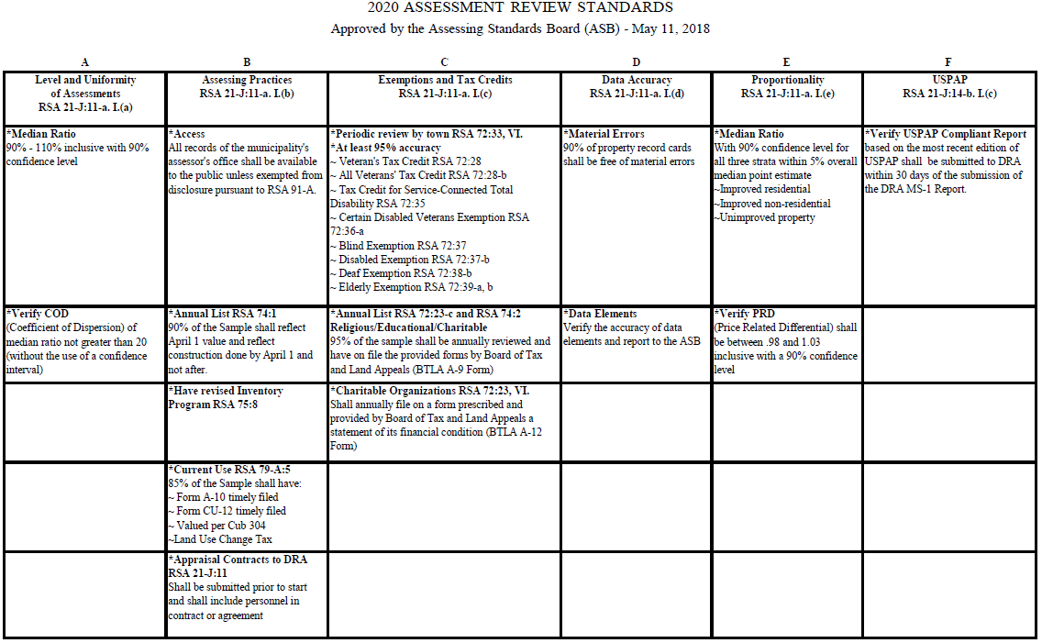
Sam Greene, Assistant Director, Municipal and Property Division
Page 36

Slide 37
Level and Uniformity of Assessments
Sam Greene, Assistant Director, Municipal and Property Division
DRA Assessment to Sales Ratio Study
The DRA conducts annually an assessment to sales ratio study for each municipality as part of the state-wide equalization process
The study compares the assessed value of the property to its selling price
Statistics are generated from Equalization data base that are indicators as to the level, uniformity, and proportionality of the assessed values
Page 37

Slide 38
Level and Uniformity of Assessments (Cont’d.)
Sam Greene, Assistant Director, Municipal and Property Division
The ASB has set the acceptable level of assessment (Median Ratio) between:
  .90 – 1.10 with a 90% confidence level
An example of calculating a single ratio:
Assessed Value (A/V) = $90,000
Selling Price (S/P) = $100,000
$90,000÷$100,000 = .90 (or 90%)
It can be said the assessed value is 90% of market value (the selling price)
Page 38

Slide 39
Level and Uniformity of Assessments (Cont’d.)
Sam Greene, Assistant Director, Municipal and Property Division
The ASB has set the acceptable level for the COD of the median ratio not greater than 20% without the use of a confidence interval.
The COD is a measure of the uniformity of the assessments.
The calculation of the COD is part of the DRA equalization process.
Page 39

Slide 40
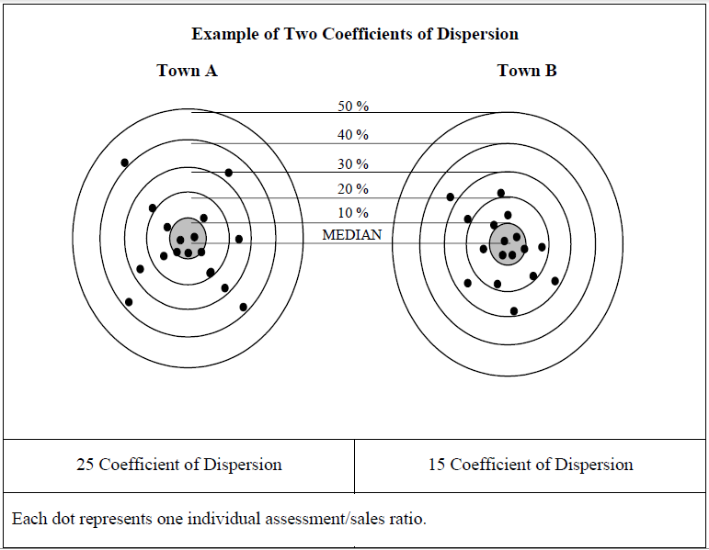
Sam Greene, Assistant Director, Municipal and Property Division
Page 40
Notes:
“Measures of Dispersion (Equity): Coefficient of Dispersion, Price-related Differential
EXAMPLE: IMAGINE A TARGET WITH A BULLSEYE (MEDIAN RATIO BEING THE EYE). THE CLOSER THE GROUPING TO THE BULLSEYE…THE LOWER THE COD. THE HIGHER THE COD THE GREATER THE SPREAD AND DISTANCE FROM THE BULLSEYE.
The statistical measures, ratio, COD, PRD, are used as indicators as to whether a revaluation or a partial revaluation is needed.

Slide 41
Assessment Practices
Sam Greene, Assistant Director, Municipal and Property Division
RSA 91-A: Access to Governmental
Records and Meetings
DRA reviews to see if the appropriate records of the municipality’s assessing office are made available to the public pursuant to RSA 91-A.
DRA also reviews whether any inappropriate records are retained (e.g. personal or financial information, social security numbers, tax returns, etc.)
Page 41

Slide 42
Assessment Practices (Cont’d.)
Sam Greene, Assistant Director, Municipal and Property Division
Assessments as of April 1st
90% of the property records reviewed in a sample should reflect the assessment as of April 1st and should not reflect new parcels or new construction that did not exist as of April 1st
The DRA monitors by obtaining a sampling of the properties for which building permits have been issued and physically inspect the properties
Page 42

Slide 43
Assessment Practices (Cont’d.)
Sam Greene, Assistant Director, Municipal and Property Division
RSA 75:8 - Revised Inventory
Annually assessors and selectmen shall adjust assessments to reflect changes so that assessments are reasonably proportional
DRA reviews to ensure that assessments are being adjusted for physical changes, ownership, zoning, abatements, boundary line adjustments, sub-divisions, etc.
Page 43

Slide 44
Assessment Practices (Cont’d.)
Sam Greene, Assistant Director, Municipal and Property Division
RSA 79-A:5 – Assessment of Open Space Land:
85% of Current Use (CU) parcels must meet criteria:
  Have A-10 Application and CU-12 Stewardship filed timely
  Meet CU criteria
  Values assessed in accordance with Cub 304
Land Use Change Tax (LUCT) Procedures:
  Tax assessed and collected
  Property record card (PRC) corrected to reflect acreage change
The DRA samples the CU properties and reviews the information in the property record file.
Page 44

Slide 45
Assessment Practices (Cont’d.)
Sam Greene, Assistant Director, Municipal and Property Division
RSA 21-J:11 – Appraisal of Property for Ad Valorem Tax Purposes
Contracts:
The DRA confirms that the appraisal service contracts or agreements for the review year have:
Been submitted to the DRA prior to the work commencing
Include the names of all personnel to be employed under the contract
Page 45

Slide 46
Exemptions and Credits
Sam Greene, Assistant Director, Municipal and Property Division
RSA 72:33, VI - Periodic Review
A periodic review should be done at least once every assessment review cycle of all exemptions and credits with at least 95% accuracy
The municipality should have the approved forms on file for the exemption or credit – (PA-29, BTLA A-9 , BTLA A-12)
The DRA will sample the exemptions and credits and check the assessment files for the areas indicated on the worksheets
Page 46

Slide 47
  Tax Exemption vs. Tax Credit
Sam Greene, Assistant Director, Municipal and Property Division
What is the difference between an exemption and a credit?
RSA 72:29, III and IV provide the answers:
“Exemption” as used in RSA 72 shall mean the amount of money to be deducted from the assessed valuation, for property tax purposes, of real property.
The term “tax credit” as used in RSA 72 shall mean the amount of money to be deducted from the person’s tax bill.
Page 47
Notes:
Remember - The goal is not to memorize the criteria and definitions but to know where to find it.

Slide 48
  Exemptions and Credits
Sam Greene, Assistant Director, Municipal and Property Division
PERSONAL - based upon applicant’s qualifications:
Veterans
Elderly
Blind
Deaf, Etc.
TAX EXEMPT - based upon class and use of property:
Religious
Charitable
Schools
Municipal, Etc.
PROPERTY QUALIFIED – specific components:
Pollution control
Portions of ski lifts
Disability improvements
Residence in a commercial zone, etc.
Page 48
Notes:
*The BTLA has the “tax exempt” form A-9 and A-12 that is filed annually for the Religious, Educational, and Charitable.
*The DRA has the PA-29 which is used for Veterans, Elderly, Blind, Deaf, etc.
*The PA-29, PA-30(deferral), PA-33 (statement of qualification) & PA-35 (municipal response to application) are all forms that you should be familiar with.
*Be aware that the forms are updated regularly. You should check the “Rev. date” at the bottom right side of the form to make sure that you are using the most recent.

Slide 49
Accuracy of Data
Sam Greene, Assistant Director, Municipal and Property Division
The level of accuracy of the data elements regularly collected by the municipality, and shown on the property record cards (PRC’s), are compared to the physical property
  90% of the PRCs reviewed must be free of material errors
  Material error is one or more errors/missing items that exceed 5% of the total assessed value or 7.5% of land only or building only
Page 49

Slide 50
Proportionality
Sam Greene, Assistant Director, Municipal and Property Division
The “DRA Assessment to Sales Ratio Study” generates a PRD for the municipality.
Price Related Differential (PRD) is a statistical analysis that measures the difference in appraisals between high and low valued assessments by dividing the mean ratio by the weighted mean ratio
The calculated PRD is reported to the ASB as part of the assessment review process
Page 50

Slide 51
Proportionality (Cont’d.)
Sam Greene, Assistant Director, Municipal and Property Division
ASB established standard for the PRD is a range from .98 to 1.03 with a 90% confidence level.
PRD is a test to see if high valued property assessments are proportional to low valued property assessments
  Example: A PRD of 1.12 indicates that high valued properties may be under assessed when compared to low valued properties.
Page 51

Slide 52
USPAP Compliant Report
Sam Greene, Assistant Director, Municipal and Property Division
A report based on the most recent edition of USPAP shall be submitted to the Municipality and the DRA for each full revaluation, partial revaluation, cyclical revaluation, or statistical update
The DRA will verify that the USPAP Report is compliant utilizing a checklist PA-50
The DRA shall report to the ASB and the Municipality on its findings
Page 52

Slide 53
RSA 21-J:14-f, I Certification Required
Sam Greene, Assistant Director, Municipal and Property Division
“Every person, whether working individually, for a firm or corporation, or as a municipal employee, making appraisals of a municipality for tax assessment purposes, except elected officials making appraisals pursuant to RSA 75:1, shall be certified by the department according to rules adopted by the assessing standards board as provided in paragraph II… ……” (Emphasis added)
Page 53
Notes:
*Paragraph II states that the ASB shall adopt rules pertaining to certification, continued ed. requirements, decertification, suspension & other disciplinary actions. The rules shall specify the minimum qualifications with respect to education & training required for each level of certification.
*PARAGRAPH III OF THIS STATUTE STATES THAT NO PERSON SHALL MAKE APPRAISALS WITHOUT CERTIFICATION (EXCEPT UNDER 75:1 elected officials) CERTIFICATIONS CAN NOT BE TRANSFERRABLE OR ASSIGNED.
* And, ANY PERSON WHO WILLFULLY FAILS TO OBTAIN CERTIFICATION IS SUBJECT OF PENALITIES UNDER RSA 21-J:39, IV.

Slide 54
RSA 21-J:14-b, I-a Powers and Duties of the Board
Sam Greene, Assistant Director, Municipal and Property Division
“The assessing standards board shall adopt rules, pursuant to RSA 541-A, relative to:”
Establishment of standards for assessing officials pertaining to:
Certification standards
Continuing education standards
Revocation, suspension, and other disciplinary standards and sanctions
Definition of, and practices that constitute sales chasing and penalties for committing or being a party to sales chasing
The DRA is responsible for the enforcement of the standards adopted by the ASB .
Page 54
Notes:
*Rules effective 2/28/12. Must comply with rules in effect at the time of application for certification. A copy of the Asb 300 rules included in the booklet.
*Everyone is required to obtain a criminal background check with request for certification or re-certification
*IF DRA CERTIFIED - ADDRESS CHANGES – YOU ARE REQUIRED TO NOTIFY THE DRA WITHIN 14 DAYS
PENALTIES ASSOCIATED WITH KNOWINGLY COMMITTING OR BEING PARTY TO SALES CHASING.
ANYONE CERTIFIED BY THE DRA SHOULD BE FAMILIAR THE ASB RULES , STANDARDS, AND ETHICS.

Slide 55
Certification by DRA
Sam Greene, Assistant Director, Municipal and Property Division
The Municipal and Property Division maintains the records for assessing certification and approves individuals based upon the ASB rules and the individual’s qualifications.
The list of DRA-Certified assessing personnel is available at the DRA website. The list provides the level at which the individual is approved.
The ASB rules specify the requirements for each certification level and also describes the specific allowable job duties.
Page 55
Notes:
*The DRA has entered the certification information into an Access database.
*IMPORTANT TO KNOW THE DIFFERENT LEVELS AND LEVELS OF DUTIES EACH MAY PERFORM –
Measurer & lister – collects data ……cannot validate/invalidate sales
Assessor assistant – under guidance of assessor or assessor supervisor – appraise various types of RE, validate or invalidate sales.
Assessor – can maintain assessments, validate invalidate sales – shall no adjust the cost, land, depreciation tables that result in value changes without approval of assessor supervisor.
Assessor supervisor – Does it all – USPAP reports, user manuals, oversees others, oversees reassessments, etc.
*It is recommended that you review the job duties to ensure that the individuals working within your municipality are performing work at their approved level.

Slide 56
Sam Greene, Assistant Director, Municipal and Property Division
Asb 307.02 - Types of Misconduct (summarized)
  Deceit-fraud, bad faith falsification in procuring DRA certification
  Allowing non-certified individuals to perform work or work above their certified level
  Negligent/willful acts inconsistent with health or safety of persons under their supervision
  Violation of NH property assessing statutes or Asb 300 or Rev 600 rules
  Suspension or decertification in another jurisdiction
  Breaching a duty of confidentiality
  Conviction in past 5 years (or since last certification) of class A misdemeanor or felony
  Not notifying DRA within 10 days of suspension or decertification from other sources
  Not including information about suspension/decertification prior to becoming DRA-certified
Page 56
Notes:
*You should read this section of the Asb rule and become familiar with it and Asb 308.
*Currently Asb 308.03 – Conduct refers to Asb 309 to be adopted – these are the Asb ethics which are to be in rule format.
*As DRA-Certified individual, you should be familiar with the Asb Code of Ethics which require compliance with USPAP ethical requirements.
*Violations could result in some instances of decertification up to 5 years.

Slide 57
RSA 21-J:14-g, I Decertification
Sam Greene, Assistant Director, Municipal and Property Division
“The commissioner may decertify any person or may refuse to issue or renew any certification for failure to comply with the rules of the assessing standards board adopted pursuant to RSA 21-J:14-f, II.”
Paragraph II of this section states that any person aggrieved by a decertification, or refusal to certify, may appeal to the B.T.L.A. or superior court.
Page 57
Notes:
As contracts and the list of assessing personnel are received by the Department – the certification list is reviewed.
If a person has been decertified, or has not be certified, they cannot “appraise” property for assessing purposes within the state. This includes the measurement and listing of property.
If you are DRA-Certified and allow a non-certified person to perform work for you, or perform work above their certification level – Pursuant to ASB rule - you could be suspended for 3 months.

Slide 58
RSA 21-J:14-k Cessation of
Unauthorized Appraisals
Sam Greene, Assistant Director, Municipal and Property Division
“The commissioner, or the commissioner’s authorized agents, may issue a written cease and desist order against any person, firm, corporation, or municipality that does not comply with RSA 21-J:11, I, or RSA 21-J:14-f. Any such act may be enjoined by the superior court, upon application of the attorney general.”
RSA 21-J:11, I refers to the contract requirement.
RSA 21-J:14-f refers to the certification requirement.
Page 58

Slide 59
RSA 21-J:39, IV Criminal Penalties
Sam Greene, Assistant Director, Municipal and Property Division
“(a) No person, except elected officials making appraisals pursuant to RSA 75:1, shall willfully engage in making appraisals of a municipality for tax purposes, unless such person is certified as provided in RSA 21-J:14-f .
(b) No person engaged in making appraisals of a municipality for tax assessment purposes shall willfully fail to maintain and provide the department access to the records required to be kept under RSA 21-J:14-e.
(c) Any person who violates subparagraph (a) and (b) shall be guilty of a class B misdemeanor.”
Page 59
Notes:
This is pretty straight forward. It not only pertains to being certified to make the appraisals - but also pertains to the record keeping and providing DRA access to the records

Slide 60
  Municipal Assessing Duties
Sam Greene, Assistant Director, Municipal and Property Division
The assessing office is the “Bread Winner” for the municipality
Incorrect assessments, disproportionate assessments, missed taxable property, improper exemptions & credits all affect the municipal “revenue stream”
Loss of revenue will result in higher tax rates to meet budgetary requirements.
Understanding how it all works is the starting point to an efficient and effective assessing office. It will never be totally error free
Page 60
Notes:
*Every department in a municipality think that theirs is the most important…but the assessing office tops them all….including the tax collectors office. No assessments or bad assessments = no tax or less tax for the collector!!
*Missed building permits & property changes. Exemption/Credit eligibility changes.
*All of this creates disproportionality within the municipality which then results in disproportionality in the EQ process.

Slide 61
  Municipal Tax Maps
Sam Greene, Assistant Director, Municipal and Property Division
Accurate tax maps help to ensure accurate assessments.
RSA 31:95-a stipulates the statutory requirements for tax maps. A copy of the RSA has been enclosed
In the valuation of property, it is essential to know about the land, zoning, permitted uses, restrictions, etc. Updated zoning maps and town regulations are tools that are needed for proper assessments
Any changes done by the Planning Board (sub-division regulations, land use regulations, sub-division approvals, boundary line adjustments, etc) affect the assessing office. Open communication between the two offices is essential
Page 61
Notes:
*A tax map is not only your roadmap to the property but is essential in the valuation process. Tax maps are compiled from deeds, surveys and plans. *Valuation of land considers location (driving factor to value), size (acres and frontages), configuration, etc.
*In summary, the statute states that the municipality shall …(not may)( …everyone know the difference?...) show the boundary lines, accurately represent the phys. Loc. of each parcel of land, show road or water frontage.
*Tax maps shall be updated at least annually PER 31:95-a.
*Having municipal maps that are digitally developed – enable the Mosiac GIS to work as show on the previous slide. It is a great tool.

Slide 62
  Maps – A Visual Guide to Valuation
Sam Greene, Assistant Director, Municipal and Property Division
Four vacant parcels of land have recently sold on Central Avenue. The lots abut each other, each have the same general topography and all have road frontage.
Can you tell why the sale prices are so different for about the same number of acres?
Lot A - 3.25 acres Sold: $50,000
Lot B - 2.85 acres Sold: $74,000
Lot C - 3.25 acres Sold: $75,000
Lot D - 3.25 acres Sold: $135,000
Page 62
Notes:
*Turn to the last colored paper in the back of your booklet.
*Now by seeing the parcels of land on the “Central Avenue” map, are there any indicators that might explain the different sale prices?
*Shape, access ?
*More frontage on a parcel of land and # of acres may increase the value due to sub-division potential. Planning Board approvals can increase the market value of a property. Commercial vs residential value, etc.

Slide 63
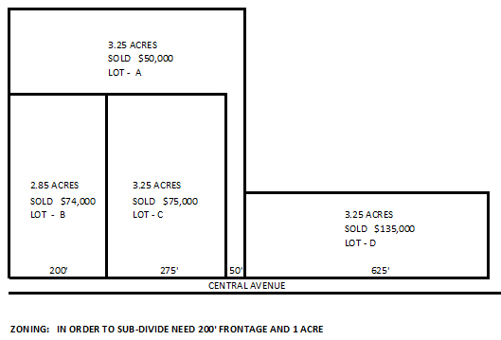
Sam Greene, Assistant Director, Municipal and Property Division
Page 63

Slide 64
  Maps – A Visual Guide to Valuation
Sam Greene, Assistant Director, Municipal and Property Division
Four parcels of land have recently sold on Lakeshore Drive. The lots abut each other, have the same general topography, and all have 200 feet of road frontage.
Can you tell why the sale prices are so different for the same number of acres?
Lot A - 2 acres Sold: $525,000
Lot B - 2 acres Sold: $800,000
Lot C - 2 acres Sold: $150,000
Lot D - 2 acres Sold: $75,000
Page 64
Notes:
Now, by seeing the parcels of land on the “Lakeshore Drive” map, are there any indicators that might explain the different sale prices?
What does the dashed line represent on Lot A? That is the difference in “value” between Lots A & B.
Lot A has a deeded 50 foot ROW across the property to Golden Pond. The owner of Lot A does not have “all the rights” to the land. How do we know this? By reading the deed.
What explains the difference between Lot C & D?
Lot C has the deeded ROW across Lot A. “Deeded water access”.

Slide 65
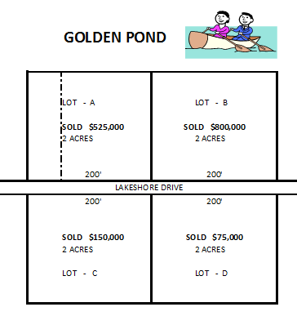
Sam Greene, Assistant Director, Municipal and Property Division
Page 65

Slide 66
  C.A.M.A.
Sam Greene, Assistant Director, Municipal and Property Division
What is “C.A.M.A.” ?
“Computerized Assessments Magically Appear ” L No
“Computer Assisted Mass Appraisal ” J Yes!!
Note the emphasis on “Assisted.” The computer program that is used to produce your assessment cards is only as good as the information that is put into it.
It is essential to understand the “inner workings” of the program and know how the tables interact.
Lack of understanding of the C.A.M.A. system has resulted in disastrous revaluations and partial updates.”
Page 66
Notes:
*Sounds like “Karma” – could be good…could be bad.
*The old adage “garbage in – garbage out” is quite appropriate.
*Your assessments are only going to be as good as the analysis and data input.

Slide 67
  C.A.M.A. (Cont’d)
Sam Greene, Assistant Director, Municipal and Property Division
Rev. 602.04 Personnel. All revaluation, partial update, and appraisal work contracts shall:
(c) “Specify that the contractor shall:
(2) For a revaluation or partial update contract, certify that a DRA-certified assessor supervisor assigned to work under the contract is proficient in the use and the calibration of the CAMA system that shall be used to appraise property;
(3) For a revaluation, partial update, data collection or assessing services contract, certify that the individual(s) assigned to perform data entry is(are) proficient in the use of the municipal CAMA system.” (Emphasis added).
Page 67
Notes:
*Calibration is defined in Rev 601.10. The process of ensuring predictive accuracy of the CAMA model through testing.
*This is part of the market analysis process – needs to be documented.

Slide 68
  C.A.M.A. (Cont’d)
Sam Greene, Assistant Director, Municipal and Property Division
Very important to remember: At the end of the tax year, after the final tax bills have been mailed, a “snapshot” of the CAMA database should be saved and the permissions should be locked down to prevent changes.
This will be your history of the assessments for that tax year. If there is an appeal of the assessment, you will want to be able to reprint the assessment information for the value being appealed.
Page 68
Notes:
*The database needs to be archived and saved for a electronic record on which the assessments were derived.

Slide 69
  RSA 79-A Current Use
Sam Greene, Assistant Director, Municipal and Property Division
The legislative purpose of Current Use (CU) was the preservation of open space – to maintain the character of the state’s landscape – and to conserve land, water, forest, agricultural and wildlife resources.
The assessed value per acre for CU is based upon the use of the land as Farm, Forest, Wetland or Unproductive. The per acre rates for Farm & Forest are based upon the income producing capability of the land.
When a person puts their land into CU it creates a recorded contingent lien on the property. Once the land is classified as CU, it cannot be taken out of CU by the owner. The land only comes out if it becomes disqualified.
Page 69
Notes:
*DRA Mini Course – Extremely in depth – 3 hours. Everything you wanted to know… ☺
*Very common question: Does the land qualify for CU ? Is it – Farm, Forest, Wetland, or Unproductive (unproductive by its nature…not man made)? If the answer is no.. Then it probably does not qualify.
*CU has a range of value. The assessment of the CU land should take into considerations the characteristics of the land. The rules are specific for the criteria for the Forest land. Farmland is determined by the use of the SPI. (soil potential index).
*Disqualified land – a physical change, or the land no longer qualifies due to size. – mowing example – guy was mowing 2 acres to get it taken out when the RE values were low. The mowing was not a physical change. Stops mowing – grass grows back. If it were that easy…all of the developers would be mowing their 50 acres…..
*Pay attention to your sub-divisions – how the lots are sold off will affect the LUCT’s

Slide 70
  RSA 79-A Current Use (Cont’d.)
Sam Greene, Assistant Director, Municipal and Property Division
As with your other assessing records and tax maps, accurate information on the land in CU, (and land not in CU = NICU), is essential for proportionate assessments
Poor record keeping and the “misadministration” of CU has resulted in the loss of thousands of dollars of revenue to municipalities
Not in current use land does not “float” around the property! The CU land is suppose to be marked by “identifiable boundaries upon the ground.” Cub. 302.03.
This has been a large problem with excavation sites that have CU land. They need to be physically reviewed yearly
Page 70
Notes:
*CU has a huge impact on the total assessed value of a municipality – especially the more rural communities.
*If not tracked and administered properly – the municipality will lose revenue & the assessments will be disproportionate.
*Excavation sites are a moving target. They excavate, reclaim and move on to virgin territory. You need to know the exact location of the original NICU land. As they move out of that area…they incur the LUCT. The LUCT for excavation sites may include the value of the minerals if it contributes to the market value of the property. The LUCT for 5 acres of backland vs 5 acres of backland with permitted excavation site containing 500,000+ cubic yards of earth should have a different “highest and best use and market value” - The LUCT is based on the earth within the 5 acres – not what they report on the intent to excavate.
***The assessor cannot sit in the office and look at the “Intent to Excavate” information – They need to physically visit the site and review the excavation plans.
*LUCT- Remember – you must use the Form A-5W for the warrant. The municipality should have supporting documentation for the LUCT estimate.

Slide 71
  RSA 79-A Current Use (Cont’d.)
Sam Greene, Assistant Director, Municipal and Property Division
“Unproductive Land” includes wetlands. The CU definition of wetland is not the same as the Department of Environmental Services wetland definition. It is unproductive by “its nature” – not man-made.
The CU law at one point in time had close to 20 categories of land. This was consolidated in the 80’s. Hundred’s of acres were thrown into the unproductive category at that time.
RUN A QUERY AND REVIEW YOUR CU FOR LARGE ACREAGE IN UNPRODUCTIVE
Page 71
Notes:
*After you have run your query, look at aerials on the property…is it really inaccessible/steep/ledge?
*Run a summary of CU – are there parcels of land that are less than 10 acres…? Double check them…do they qualify – are they contiguous and in common ownership with other CU land?
*Is the other CU land over the town line…? Check with the other municipality to make sure that land still qualifies for CU.

Slide 72
  Common CU Assessing Errors
Sam Greene, Assistant Director, Municipal and Property Division
Non-CU land annexed to CU parcel by boundary line adjustment - Assessed as CU
Buildings “Picked Up” – LUCT not assessed
Lot conveyed – other lots disqualified – LUCT not assessed
Excavation sites: Assessors using the Notice of Intent to Excavate information to assess the property
  The information provided by the property owner may not be accurate
  Excavations are a moving target that need to be physically reviewed yearly
  The LUCT is based upon the intent volume, not including the remaining volume still in the ground
  The NICU land floating around the property
Page 72
Notes:
*If the annexed land is not in CU at the time of transfer, it cannot be assessed as such. An application needs to be made.
*Buildings picked up, building data entered, land line assessment changed but no LUCT ever issued. Past statutory collection – do release – no $$
*Follow though on sales to make sure surrounding common ownership lots still qualify. Run a query on CU – check out lots under 10 acres.
*When land type categories were changed many years ago, much of it wound up in Unproductive. Needs through review.
*Assessors are looking at the Intent information on Line 10 “Excavation Area as of April 1”. Many owners feel that this is the “face” of the pit. Not the other disturbance. Recently found a property several months ago that was assessed for 8 acres NICU which should have been 50+ acres NICU. Major loss of assessment revenue over the past 10 years.

Slide 73
  RSA 79 – Forest Conservation and Taxation
Sam Greene, Assistant Director, Municipal and Property Division
Timber is taxed at the time it is cut: “Yield Tax” is 10% of stumpage value. (Value of timber standing on the stump)
Prior to cutting wood, a PA-7, Notice of Intent to Cut must be signed by the assessing officials
Assessing officials have 30 days to sign the intent and forward it to the DRA
Assessing officials must notify the tax collector of the signed intent
Assessing officials may decline to sign due to:
  Improper or incomplete form
  Land to be cut is in CU unproductive
  No timber bond posted “if required”
  All owners of record have not signed
Page 73
Notes:
*Timber was considered to be part of the real estate and taxable. Due to heavy cutting and as in incentive to grow wood – RSA 79 was enacted in 1949. In addition, the NH Constitution was changed.
*”Timber Tax” is actually a “Yield Tax”
*A copy of the signed intent shall be given to the tax collector due to the contingent lien on the property for taxes due.
*The intent cannot be declined for any other reason.

Slide 74
  RSA 79 – Forest Conservation and Taxation (Cont’d.)
Sam Greene, Assistant Director, Municipal and Property Division
Exemptions from the intent to cut:
  10 MBF saw logs and 20 cords fuel wood for personal use by the owner.
  10 MBF saw logs and 20 cords of wood or equivalent in tree chips for land conversion when all permits are in place.
  Shade and ornamental trees
  Christmas trees, fruit trees, nursery stock and short rotation tree fiber.
  Any amount of firewood for maple syrup production.
  Any government or utilities not selling the wood.
Page 74
Notes:
*Note that the exemptions are per owner, per town, per tax year.
*Cost of removal of shade trees usually exceeds any attributable value. Within striking distance of buildings.
*No “timber” value or wood value – grown for a specific purpose.
*Most syrup production has moved on to other energy source.
*Power line clearing, airport easements.

Slide 75
  RSA 79 – Forest Conservation and Taxation (Cont’d.)
Sam Greene, Assistant Director, Municipal and Property Division
Upon receipt of the report of timber cut, the assessing officials have 30 days to assess the yield tax
The DRA sends out surveys to establish the stumpage value ranges. The stumpage value sheets are published twice per year. They are available on the DRA website
The report of timber cut indicates when the cutting ended. This will assist in determining which stumpage price sheet to use
The assessing officials are not required to use the stumpage value sheets if they have other evidence of value
If the stumpage price sheets are being used, a straight 50% of the value estimate is not appropriate. The percentage used should be based upon quality, location, size of cut, and other factors that may affect value
Page 75
Notes:
*The DRA website contains a time line for extension and due dates for reports. Also stumpage value rates, conversion chart, etc.
*The estimate of value should consider the:
Quality - height, diameter, defect
Location – access to public roads, physical geography
Size – economy of scale and,
Other factors that may affect value.
*If municipality uses other evidence of value other than the DRA stumpage value sheets – need documentation to support value.
Such as contracts, comparative / competitive bid results, road construction costs, etc.

Slide 76
  RSA 79 – Forest Conservation and Taxation (Cont’d.)
Sam Greene, Assistant Director, Municipal and Property Division
“TIMBER MATRIX” - DRA has a sample matrix to use for timber valuation
“YIELD TAX BILLING” - DRA has a “spreadsheet” that can assist the municipality in the billing process. The same spreadsheet can be utilized in the estimate of a timber bond. Now available on our website
“CERTIFICATION OF YIELD TAX” - The assessing officials are required to certify to the DRA the amount of timber billed
NEW TIMBER RULES !!! Rev. 3400. Effective 8-21-2019
Page 76
Notes:
If you have questions on the yield tax, the rules were designed to answer frequently asked questions and to clarify the law. Check them out!

Slide 77
  RSA 72-B – Excavation Tax
Sam Greene, Assistant Director, Municipal and Property Division
Law effective January 1, 1998. $.02 (cents) per cubic yard.
The legislature stated that RSA 72-B must be read in conjunction with RSA 155-E. Land area that is used for commercial excavation must have all local and state permits in place
Excavation of earth for incidental projects are subject to RSA 72-B if more than 1,000 cubic yards will leave the property
The assessing officials may decline to sign the intent for non-compliance with RSA 155-E, RSA 485-A:17, RSA 72-B:5 or RSA 79-A within 30 days of receipt of the intent. Must follow Rev. 503.01
The Notice of Intent to Excavate is not an excavation permit. It is a tax document. It is not a RSA 155-E enforcement tool
Page 77
Notes:
*Modeled after the Yield tax process. Similar process. But – no extension – new Intent to Excavate required every year – April 1 or before excavation.
RSA 155-E is the local regulation of the excavation of earth. Either a permit, or an “exception” from a permit, must be obtained.
*The legislature stated that reading the two together would provide for a comprehensive regulatory framework pertaining to the excavation of earth. In addition to RSA 155-E, DES also requires an Alteration of Terrain permit.
*If the assessing officials decline to sign the form, they must notify the applicant in writing as to why and provide a remedy – see rule on certification by assessing officials.
*The notice of intent to excavate is not an enforcement tool and is not a “permit to excavate”.
*The regulator of RSA 155-E (planning boards mostly) need to work together with the assessing office.

Slide 78
  RSA 72-B – Excavation Tax (Cont’d.)
Sam Greene, Assistant Director, Municipal and Property Division
If a property for which an Intent has been filed is sold, the previous owner needs to file Report of Excavated Material and the new owner needs a new Intent and administration fee
Upon receipt of the Report, assessing officials have 30 days in which to assess the tax
Tax Collector needs to be notified that the Intent has been filed. Contingent lien on property for Excavation Tax
The Report of Excavated Material is not available on the DRA website. They must contact DRA for a duplicate copy
RULES: Rev. 500
Dimension Stone – not the same as earth. This type of quarry is taxed under RSA 72:13. Assessment can contain the value for the minerals contained in the ground
Page 78
Notes:
*This is true for Yield Tax. Property sells or different logger.
*The Tax Collector needs to be notified of the signed intent. Creates a contingent lien on the property for taxes due.
*This is also true for Yield Tax – Reports are not available on the website.

Slide 79
  RSA 72-B – Excavation Tax (Cont’d.)
Sam Greene, Assistant Director, Municipal and Property Division
The property tax assessment for the land area utilized for a commercial excavation shall not contain the value of the earth. It should be noted that the excavation and processing of earth is a highly regulated commercial/industrial activity. In assessing the property, it must be a legal and permitted use. The assessor needs to know the amount of “permitted” land area in determining the assessment of the property.
The assessor cannot determine the value or excavated area of the property from the office using the intent to excavate form. Yearly physical inspections are a must.
Aerial photographs and GPS are other tools that can assist in the valuation of the property.
Earth may not be exempt from a LUCT. The plans that are submitted for local and state permits can be essential in determining the proper LUCT assessment.
Page 79
Notes:
Remember, in the LUCT… the use of the property must be a legal use. The earth may or may not contribute to the value of the property. The determination of the LUCT is an appraisal and must be supportable.

Slide 80
RSA 21-J:9-a Equalization Procedure
Sam Greene, Assistant Director, Municipal and Property Division
Not all municipal assessments are at 100% of market value due to the ever changing real estate market. The local assessed value of all taxable property minus specific exemptions is the “modified” assessed valuation.
The “modified” assessed values are equalized to bring all municipalities to 100% of market value for the purpose of:
  Apportionment of county taxes
  Apportionment of state education property tax
  Apportionment of regional/cooperative school taxes
  Apportionment of other shared expenses such as waste facilities and mutual aid fire costs
Page 80
Notes:
*This is a very brief summary – State Statutes Part II goes over the procedure in depth!
*The DRA follows the Asb guidelines in the equalization process.
*2014- New Updated EQ Manual
*All municipalities do not assess their properties at 100% of market value due to the ever changing real estate market. The EQ process accounts for this.
*This section is a very brief summary of the purpose of Equalization. If you need a better understanding of the process itself, it is recommended that you take the State Statutes Part II where Equalization is explained in great detail.
*It is the assessing officials responsibility to ensure that the assessments are proper. The fact that values are equalized for the disbursement and allocation of other taxes by County and State, makes it imperative that assessments within the municipalities are fair and equitable.
Equality on a state wide basis.
THE DEPARTMENT PRODUCES EXTENSIVE REPORTS REGARDING THE MUNICIPALITIES FROM THIS INFORMATION.

Slide 81
  Ratio Study
Sam Greene, Assistant Director, Municipal and Property Division
The DRA annually conducts a sales-assessment ratio study for each municipality as part of the equalization process. The study compares the assessed value of the property to its selling price.
The DRA Equalization program is utilized for the annual sales ratio study. The DRA obtains electronic copies of the municipal assessment database each year. The program matches the municipal assessment parcel information to the electronic sales information obtained from the registry of deeds.
Updated tax map information is also obtained from the municipality to update the tax map overlay.
Page 81
Notes:
*Are you the person that uses the Mosaic program in your municipality to verify the sales for the EQ process? *This is a great tool for the assessor to find comparable sales or information about abutting properties, etc.

Slide 82
  Ratio Study (Cont’d.)
Sam Greene, Assistant Director, Municipal and Property Division
The municipality continues to provide information to the DRA as to why a sale may need to be excluded, the reason for a change in assessed value, the property code “strata” category, etc.
After a thorough review of the municipal information by the equalization staff, the statistics are calculated. The ratio is used to “equalize” the assessments.
The statistics that are generated from the ratio study are also indicators as to the level, uniformity, and proportionality of the assessed values within the municipality.
Page 82
Notes:
*The DRA calculates the “Measures of Assessment Level”, Weighted Mean, Median, and Mean Ratios. “Measures of Dispersion (Equity): Coefficient of Dispersion, Price-related Differential. A “stratified” analysis is performed based upon the strata type: land only, residential, commercial, waterfront, condos, etc.
*The ratio study is an essential tool for the assessing officials to help identify assessment problem areas.
*The DRA uses the ASB established standards pertaining to the acceptable level and uniformity of the assessments for their assessment review.

Slide 83
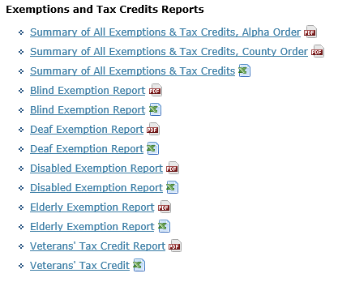
  Also on the DRA website https://www.revenue.nh.gov/mun-prop/property/equalization-2018/index.htm
Sam Greene, Assistant Director, Municipal and Property Division
Page 83
Notes:
*In “property”, “equalization” there are many annual reports that are produced. This “snapshot” is by County. Can also be sorted by municipality. Check it out!
*If the assessing officials are wondering about changing the amount of the elderly exemption, this information is available as to what other municipalities are doing.
Also has blind, solar, etc. How many acres are in CU, Cons. Restriction Assessment? What municipality has the lowest tax rate??
Could be important if you are planning on moving somewhere!

Slide 84
  Setting of Tax Rates by Commissioner
Sam Greene, Assistant Director, Municipal and Property Division
RSA 21-J:35, I. The commissioner of revenue administration shall compute and establish the tax rate of each town, city, or unincorporated place.
259 Municipal Rates
259 School Rates
259 State Education Rates
259 County Rates
114 Village Districts Rates
Total of 1,150 Individual Rates
Accuracy Rate: 99.91%
Review 6,500 Tax Rate Documents
Page 84

Slide 85
  Board of Tax and Land Appeals (BTLA)
Sam Greene, Assistant Director, Municipal and Property Division
The general duties and powers of the BTLA are stated in RSA 71-B.
BTLA may hear and determine:
All matters involving questions of taxation
Appeals by municipalities relating to the equalized valuation of property as determined by the DRA
All matters relating to condemnation of property for public uses and assessment of damages. RSA 498-A Eminent Domain
All matters relating to orders for reassessment
Each “Matter” has its own statute in which the appeal deadlines are specified. The BTLA website has a table of filing deadlines
Page 85
Notes:
After tax rates and bills go out – you may get appeals, or your ratio may be appeals.
*The BTLA site contains the “A-9” (List of Real Estate on which Exemption is claimed) and “A-12” forms (Charitable Organization Financial Statement). These are the forms that religious, educational, & charitable organizations must use for exemptions. Appeal forms are also found at the BTLA site.
*As part of the Boards review of a municipality, the ratio study & EQ report are factors in determining the need for a reassessment. They may also look at the DRA monitoring reports.
*The Board has staff members that they direct to investigate an appeal or petition for reassessment –a report is produced for BTLA by staff.
*A BTLA order could include a full reassessment of all property or a segment.
Note that the BTLA also hears appeals pertaining to the decertification of assessing personnel.

Slide 86
  Board of Tax and Land Appeals (Cont’d.)
Sam Greene, Assistant Director, Municipal and Property Division
Property Tax Appeals:
Must be filed with the municipality by March 1 (as long as final tax bills were sent by 12/31).
The municipality has until July 1 to either deny or grant the appeal.
If the municipality refuses to abate, or fails to respond by July 1, the taxpayer has until September 1 to file with either the BTLA or superior court. Cannot appeal to both within same tax year.
Important recommendation:
As deadlines approach, the envelope that the appeal or application was mailed in should be kept. Timely filing is determined by the date that it was mailed, not the date that the municipality received it. Hand delivered appeals and applications should be date stamped and initialed.
Page 86
Notes:
*Documentation of timely filing is extremely important not only for the property tax appeal but also for applications (CU, charitable, religious, educational, exemptions & credits, etc) and other appeals, ( CU, timber tax, excavation tax, etc).
*It is important to keep copies of assessment cards in your file. It usually takes time for the B.T.L.A. to hear property tax appeals. If a property assessment gets changed (say they added on or renovated the house after the original appeal) the B.T.L.A. will need to have a copy of the property record card showing how it was appraised for April 1 of the year appealed.

Slide 87
Municipal and Property Division
THANK
YOU
FOR
ATTENDING
Page 87

